Slide 1
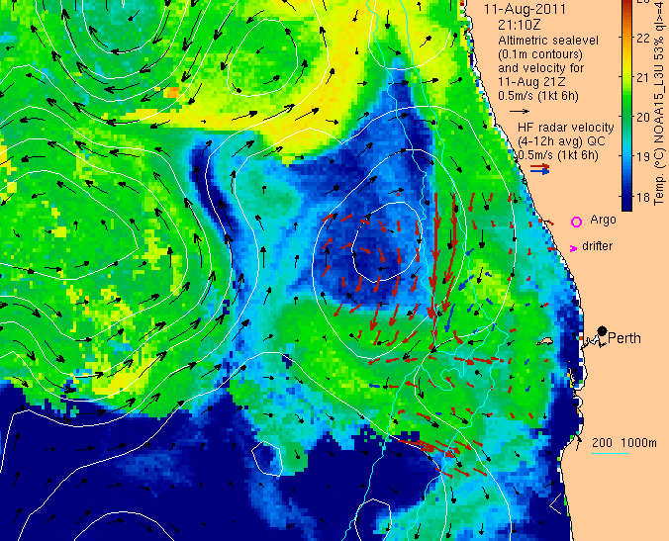
Oceancurrent.imos.org.au
David Griffin & Madeleine Cahill
CSIRO Marine and Atmospheric Research

Slide 4
18 Jan 2013: EAC as a laminar jet. Cooler shore temperature south of Brisbane.

Slide 5
Geostrophic upwelling along coast e.g. at Coffs

Slide 6
EAC wrapping around an eddy off Sydney

Slide 7
+11days: Much more cool water at shore.

Slide 8
Strong upwelling-favourable wind on 28 Jan

Slide 9
Sfc flow offshore (to SE) at CH70 ADCP on 29 Jan, then strong reversal to N by 2 Feb. Why?

Slide 10
Cloudy, so SST no good. Radar seems to disagree with ADCPs

Slide 11
SST better by 2 Feb. Radar and ADCP both show flow to N.

Slide 12
5 Feb: 10km-dia eddy 20km south of ADCPs.

Slide 13
Summary:
EAC geostrophic uplift, so cold water on shelf
Strong wind upwelled cold water to surface
Two processes drive eddy formation:
1) cold anomaly naturally cyclonic, but NB only 10km diameter
2) vorticity transfer from EAC to eddy

Slide 14
21 June 2013 news item: Ocean currents too strong for NSW lobster fishers

Slide 15
Cyclonic eddy formed off Newcastle on 5/3/13. Argo: 200m upward heave off JB 16/4/13

Slide 16
Persistent northward flow on shelf JB-Syd for 6 weeks

Slide 17
23 April 2013

Slide 18
16 May 2013

Slide 19
31 May 2013

Slide 20
16 June 2013

Slide 21
9 May 2013 glider track: 23 Mar-28 May

Slide 22
Summary
According to a lobster fisher’s 30-y diary, this year’s cyclonic eddy off JB was a very rare (long-lived) feature
Sampled by an Argo float then a glider
Replaced by a warm eddy, so Sydney’s coastal waters were ~2° warmer in May & June than April.

Slide 23
Extreme current (and sea level) events in GAB

Slide 24
SAIMOS ADCP data for 2010-2012

Slide 26
21 May 2011 Pulse of flow to SE

Slide 27
Westerly wind from small, deep low in GAB

Slide 28
10 May 2012

Slide 29
8 May 2012

Slide 30
5 Sep 2012

Slide 31
4 Sep 2012

Slide 32
Summary
Three cases similar, but do differ
Why is the max current in inner shelf sometimes, and outer shelf other time?
Need to investigate details of wind forcing; local vs propagating (CTW) components, and influence of eddies.

Slide 33
Conclusions
IMOS is producing a wealth of observations that are available to all, some in near-real time, others just a few mo afterwards.
OceanCurrent provides a quick-look, to help everyone make best use of the data.
News items draw attention to features of special interest.
Please join the (too short!) list of contributors
A special thanks to all our IMOS colleagues for doing the deployments and data management.

Slide 34
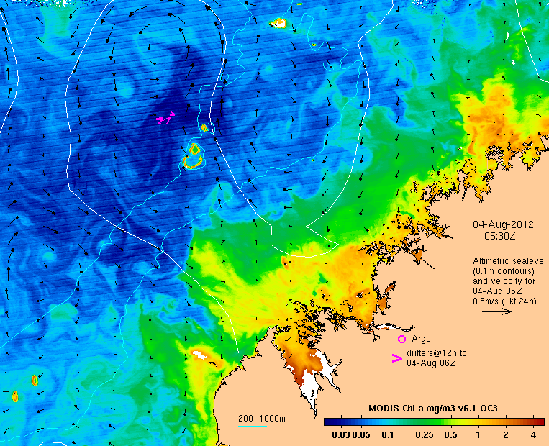
Thank you
David Griffin & Madeleine Cahill
+61 3 6232 5244
David.Griffin@csiro.au
oceancurrent.imos.org.au
CSIRO Marine and Atmospheric Research

Slide 35
